Slide 1
Cyber Defense Technology Networking & Evaluation
Esha Desai
USC ID: 6993245898

Slide 2
Objective
Cyber Defense Technology Experimental Research (DETER):Experimental infrastructure for developing security technologies
Evaluation Methods for Internet Security Technology (EMIST): Develop classes which represent network attacks & defense mechanisms
Focus on 3 classes of attacks : Worms, DoS & attacks on Internet’s routing infrastructure
Evaluate particular attack/defense using testing scenarios and unify the results
Monitor new Internet security breaches
Adapt to different testbeds including simulation(NS), emulation(Emulab) & hardware testbeds
Include attack simulators, generators for topology, background traffic, live traffic
Effectively combine emulation, simulation and real hardware to develop defense mechanisms
Allow researchers to test their own defense mechanism designs

Slide 3
Testbed Architecture & Requirements
Exists as three permanent network clusters at ISI(LA), ISI(Virginia) and UC-Berkeley.
Testbed to be fully isolated from Internet
Would generate destructive traffic to cause temporary network damage
Would host around 1000 PCs each with multiple NICs.
Would have routers, switches and a complex topology which can correlate with the Internet and it’s benefit & attack traffic
Software for Traffic generation, network monitoring, analysis, registration, archiving etc.
X-Bone for node revisiting

Slide 4
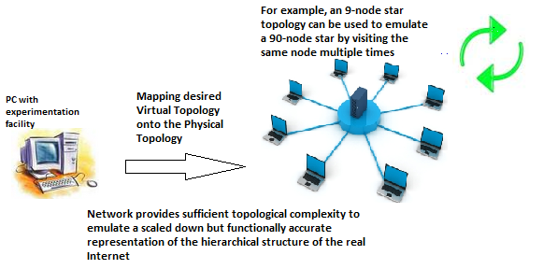

Slide 5
Question
What problems were faced in developing Cyber
Defense mechanisms? How did DETER bring a
solution to it?
The real Internet and the sort of attacks that happen were not really reflected by the Existing research facilities and mechanisms
These facilities were too small scaled to mirror the complex Internet and the attacks
DETER converged emulation, simulation and real hardware to achieve this. It merged an experimental infrastructure with testing methodologies that reflected real attack sets. It serves as a platform for researchers to evaluate their defense mechanisms against realistic attack traffic.

